Slide 1

RE-ORIENTATION ON SIMPLIFIED ACCOUNTING GUIDELINES & PROCEDURES FOR
UTILIZATION OF SCHOOL MOOE
January 16-21, 2017
8:00am – 5:00pm

Slide 2








PROGRAMME
I. Registration
II. Opening Program
III. Re-Orientation on the Guidelines for Liquidation of School MOOE
IV. Orientation on the Preparation of Request for Cash Advance
V. Workshop
VI. Closing Program

Slide 3
RE-ORIENTATION ON THE GUIDELINES FOR LIQUIDATION OF SCHOOL MOOE

Slide 4

Topics
Cash Advance
Purpose of Cash Advance
Requirement for the grant of Cash Advance
Reminders for Cash Advance
Cash Disbursement Register (CDR)
How to record receipts of Cash Advance to CDR?
  On the Cash Advance Section
  On the Breakdown of Payments Section
  Closing the Register
Liquidation

Slide 5
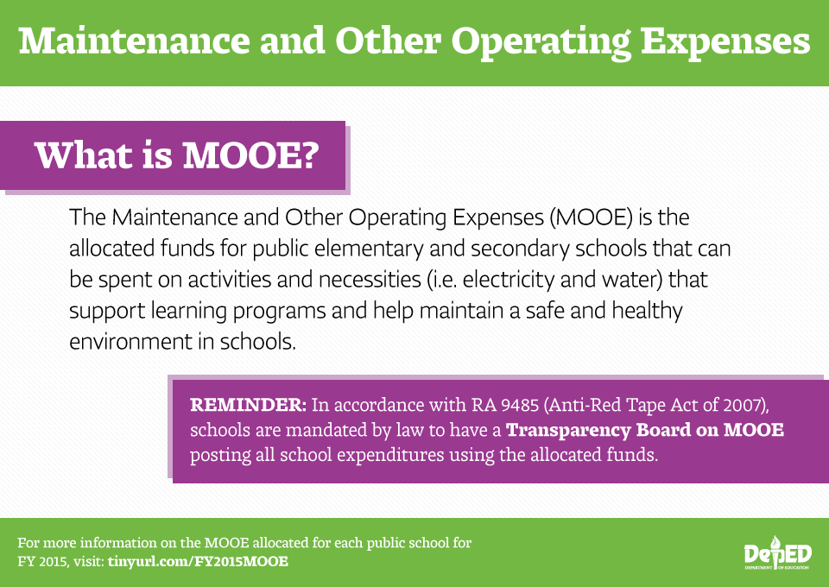

Slide 6
Uses of School MOOE
To fund activities as identified in the approved School Improvement Plan (SIP) for implementation in the current year and as specifically determined in the Annual Implementation Plan (AIP) of the school.
To support expenses for school-based training and activities that are selected or designed to address the most critical needs that will improve learning outcomes.

Slide 7
Uses of School MOOE
To finance expenses pertaining to graduation rites, moving up or closing ceremonies and recognition activities.
To procure school supplies and other consumables for teachers and students deemed necessary in the conduct of classes.

Slide 8
Uses of School MOOE
Uses of School MOOE
To fund minor repairs of facilities, building and grounds maintenance and the upkeep of the school.
To pay for wages of full-time janitorial, transportation/mobility and security services.
To pay for utilities and communication expenses.

Slide 9
Uses of School MOOE
In no case shall the school MOOE be used for the procurement of school furniture (such as seats, and teacher’s table and chairs), and textbooks and other instructional materials, even if these expenditures are contained in the SIP.

Slide 10
Various forms used in the liquidation of MOOE

Slide 11
Various Proof of
Receipts

Slide 12
Chart of Accounts

Slide 13
Traveling Expenses – Local
5020101000
To record the costs incurred in the movement/transport of government officers and employees within the country. It includes transportation fare and travel per diems, ferriage, and all other similar expenses

Slide 14

Supporting Documents:
approved itinerary of travel (Appendix A & B)
certificate of appearance
authority to travel approved by the agency head
within the District - signed by School Head
within the Division - signed by DS
outside the Division - signed by SDS
Reference/Memo (chargeable to local fund)
Note: Please attach ticket for CERES & Taxi fare.

Slide 15
Training and Seminar Expenses
5020201000
To record the costs incurred for the participation/attendance in and conduct of trainings, conventions and seminars/workshops.

Slide 16
Supporting Documents:
In conducting training:
Training Course Design (TCD)- Division Approved
Approved Budget Proposal
Attendance Sheet
Payroll for Meal Allowance or Official Receipt
Official Receipt & usual supporting documents for purchased supplies

Slide 17
Supporting Documents:
In attending training:
Official Receipt for Registration Fee
Memorandum
Certificate of Appearance ( to support each date of travel)

Slide 18
Office Supplies Expenses
5020301000
To record the cost or value of office supplies used such as bond paper, ink, and small tangible items like stapler wire remover, puncher, stapler and other similar items issued to end-users for government operations.

Slide 19
Supporting Documents:
Less than 2,000
Official Receipt
Requisition and Issuance Slip
Purchase Request
Inspection and Acceptance Report
2,000 and Above
Official Receipt
Requisition and Issuance Slip
Purchase Request
Canvass Paper ( 3 suppliers)
Abstract of Bids
Purchase Order
Inspection and Acceptance Report

Slide 20
Electricity Expenses
5020402000
Water Expenses
5020401000
Official Receipt excluding penalty
Priority Expense of the current month.

Slide 21
Telephone Expenses
5020502000
Cost of authorized telephone consumption incurred in school operation. It includes cell cards and bills from telecommunication companies.
For Cluster Heads - P 500.00 load allowance
- Official Receipt
For Cluster Members - P 150.00 load allowance
- Official Receipt
Non-cumulative Expense.

Slide 22
Security Expenses and Janitorial Expenses
5021202000
Supporting Documents:
Payroll
DTR signed by the Principal/School Head
Contract or Memorandum of Agreement (MOA) signed by the School Head & the Contracting Person and must be witnessed by the District Supervisor and the PTA President

Slide 23
R&M – School Buildings
5021304002
Repairs for classrooms such as repainting, minor construction of CR, windows, ceiling, doors, roofs, installation of electrical wirings, etc..

Slide 24
Supporting Documents:
Purchases of Materials less than 2,000
Official Receipt
Delivery Receipt (if OR)
Requisition and Issuance Slip
Purchase Request
Inspection and Acceptance Report
Pictures if not implemented (colored)
2,000 and Above
Official Receipt
Delivery Receipt (if OR)
Requisition and Issuance Slip
Purchase Request
Canvass Paper ( 3 suppliers)
Abstract of Bids
Purchase Order
Inspection and Acceptance Report
Pictures if not implemented (colored)

Slide 25
Payment of Labor Cost – 30% of purchased materials.
Payroll for Pakyaw or RER
Job Order
Program of Works (2,000.00 & above)
Acceptance of Finished Minor Repair
Colored Pictures (original & 2nd copy) – for all repair & maintenance regardless of the amount (before, during and after)

Slide 26
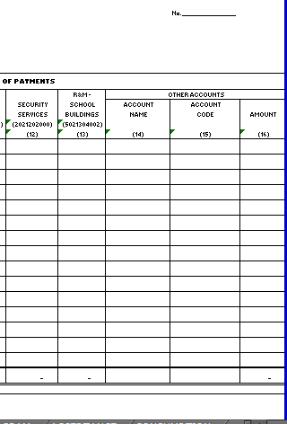
Other Accounts

Slide 27
R&M – ICT
5021305003
For repair of IT equipment and software.
Official Receipt or RER
Job Order

Slide 28
Internet Subscription Expenses
5020503000
Official Receipt
Memo for LIS updating/Reports
Maximum of 300.00 per month for LIS encoding and submission of reports

Slide 29
To record costs of printing or photocopying and binding of manuscripts, documents, forms, manuals.
Example: Reproduction of test papers, MOOE forms, etc.
Printing and Publication Expenses
5029902000

Slide 30
Supporting Documents:
Less than 2,000
Official Receipt
Requisition and Issuance Slip
Purchase Request
Inspection and Acceptance Report
List of Recipients (itemized and signed by teachers)
2,000 and Above
Official Receipt
Requisition and Issuance Slip
Purchase Request
Canvass Paper (3 suppliers)
Abstract of Bids
Purchase Order
Inspection and Acceptance Report
List of Recipients (itemized and signed by teachers)

Slide 31
Fidelity Bond Expenses
5021502000
Deposit Slip (c/o bank)
Authority to Accept Payment (ATAP) – Bureau of Treasury
Confirmation Letter (optional)

Slide 32
Other Office Supplies Expenses
5020399000
To record cost and value of other supplies used in the school operation.
Example: Tarpaulin/Streamers, ID’s, cleaning supplies & materials, curtains, pesticides, hand washing supplies, ribbons, medals, printer, etc.

Slide 33
Supporting Documents:
Less than 2,000
Official Receipt
Requisition and Issuance Slip
Purchase Request
Inspection and Acceptance Report
List of Recipients (for ID’s); Acknowledgement Receipt for Equipment for inventoriable items
2,000 and Above
Official Receipt
Requisition and Issuance Slip
Purchase Request
Canvass Paper
Abstract of Bids
Purchase Order
Inspection and Acceptance Report
List of Recipients (for ID’s); Acknowledgement Receipt for Equipment for inventoriable items

Slide 34
(1) Garden Tools
Official Receipt
Requisition and Issuance Slip
Purchase Request
Inspection and Acceptance Report
Acknowledgement Receipt
(2) Groceries
Official Receipt
Requisition and Issuance Slip
Purchase Request
Inspection and Acceptance Report

Slide 35
(3) Gasoline Expenses
Official Receipt
Consumption Report (any amount)
Requisition and Issuance Slip
Purchase Request
Inspection and Acceptance Report
(4) Medicines
Official Receipt
Requisition and Issuance Slip
Purchase Request
Inspection and Acceptance Report
Acknowledgement Receipt

Slide 36
(5) Liquefied Petroleum Gas (LPG)
Official Receipt (quarterly only)
Requisition and Issuance Slip
Purchase Request
Inspection and Acceptance Report
Acknowledgement Receipt
(6) Kitchen Utensils (for HE)
Official Receipt
Requisition and Issuance Slip
Purchase Request
Inspection and Acceptance Report
Acknowledgement Receipt

Slide 37
To record expenses which are not classified in any of the specific accounts.
Examples: Repairs of Path walk, Stage, Flag pole, Office of School Head, etc.
Other MOOE
5029999099

Slide 38
(1) Purified Drinking Water
-other supplies exp.
Official Receipt
Requisition and Issuance Slip
Purchase Request
Inspection and Acceptance Report
List of Recipients (received by teachers)
(2) Hauling
RER ( specify distance)

Slide 39
(3) District Clerk
Payroll
DTR
Contract
(4) Rental of Sound
  RER
  Job Order

Slide 40
The Liquidation should be accompanied with:
Liquidation Report (LR) – 3 copies
MOOE Payroll – 2 copies
Disbursement Voucher (DV)
Cash Disbursement Register (CDR)
Additional requirements as deemed necessary to support the validity of claims.

Slide 41
Things to remember when liquidating:
For thermal receipts, have them photocopied.
Be mindful of the receipt’s expiration/validity.
Receipts should be written in black or blue pens only.
“Assorted groceries/items” in the receipt is not accepted.
No alteration of OR.

Slide 42
Things to remember when liquidating:
The Cluster Members shall submit their liquidations to their respective Cluster Heads with one (1) original copy (for COA) and one (1) 2nd copy (for Accounting).
All liquidations of each cluster must be filed in one folder only according to the sequence of schools in the payroll. Liquidation should be submitted a week prior to the set deadline .

Slide 43
Thank You for listening!

